Slide 1


Mohsen Doust
10/23/2023

Slide 2

Outline
Executive Summary
Introduction
Methodology
Results
Insights drawn from EDA
Launch Sites Proximities Analysis
Build a Dashboard with Plotly Dash
Predictive Analysis (Classification)
Conclusion
Appendix

Slide 3
Executive Summary
This project is focused on predicting the success of Falcon 9 first stage landings, crucial for reducing SpaceX launch costs. Methodologies:
Problem Definition: Determine Falcon 9 first stage landing probability for cost estimation.
Data Handling: Python and Pandas for dataset collection, cleaning, and preprocessing.
EDA: Explored dataset for insights into landing success factors.
Machine Learning: Logistic Regression, SVM, Decision Tree, and KNN models for predictions.
Hyperparameter Tuning: GridSearchCV optimized model performance.
Model Evaluation: Accuracy and confusion matrices assessed model reliability.
Conclusion:
Accurate Support Vector Machine predictions offer insights, optimizing SpaceX launch costs.

Slide 4
Introduction
SpaceX advertises Falcon 9 rocket launches on its website with a cost of 62 million dollars; other providers cost upward of 165 million dollars each, much of the savings is because SpaceX can reuse the first stage. Therefore, if we can determine if the first stage will land, we can determine the cost of a launch. This information can be used if an alternate company wants to bid against SpaceX for a rocket launch. In this project, we will predict if the Falcon 9 first stage will land successfully.

Slide 5

Section 1

Slide 6
Methodology
Executive Summary
Data collection methodology:
Data was collected by using SpaceX API and by web scraping to collect Falcon 9 historical launch records from a Wikipedia page titled `List of Falcon 9 and Falcon Heavy launches`
Perform data wrangling
performed some Exploratory Data Analysis (EDA) to find some patterns in the data and determine what would be the label for training supervised models.
Performed exploratory data analysis (EDA) using visualization and SQL
Performed interactive visual analytics using Folium and Plotly Dash
Performed predictive analysis using classification models
Used several classification models and compared the result to Find the method performs best

Slide 7
Data Collection
Data was collected by making a get request to the SpaceX API. Some data wrangling (like dealing with missing data) and formatting was applied.
Some data was also collected by web scraping to collect Falcon 9 historical launch records from a Wikipedia page titled `List of Falcon 9 and Falcon Heavy launches`: https://en.wikipedia.org/wiki/List_of_Falcon_9_and_Falcon_Heavy_launches

Slide 8
Data Collection – SpaceX API
Requesting rocket launch data from SpaceX API:
spacex_url=https://api.spacexdata.com/v4/launches/past
response = requests.get(spacex_url)
Decoding the response content as a Json and turning it into a Pandas DataFrame:
data = pd.json_normalize(response.json())
constructing our dataset using the data we have obtained. Combining the columns into a dictionary:
launch_dict = {'FlightNumber': list(data['flight_number']),
'Date': list(data['date’]),…}
creating a Pandas DataFrame from the dictionary:
df = pd.DataFrame(launch_dict)
We made a request to get rocket launch data from SpaceX API and turned it to Pandas DataFrame.
GitHub: Collecting the data

Slide 9
Data Collection - Scraping
performing an HTTP GET method to request the Falcon9 Launch HTML page, as an HTTP response:
response = requests.get(static_url)
Creating a `BeautifulSoup` object from the HTML `response`:
soup = BeautifulSoup(response.text, 'html.parser')
Extracting all column/variable names from the HTML table header:
html_tables = soup.find_all('table')
Creating a data frame by parsing the launch HTML tables:
creating an empty dictionary with keys from the extracted column names.
Converted the dictionary into a Pandas dataframe
We performed web scraping to collect Falcon 9 historical launch records from a Wikipedia page titled `List of Falcon 9 and Falcon Heavy launches`
https://en.wikipedia.org/wiki/List_of_Falcon_9_and_Falcon_Heavy_launches
GitHub: Web scraping Falcon 9 and Falcon Heavy Launches Records from Wikipedia

Slide 10
Data Wrangling
Finding rows with missing values in our dataset:
data_falcon9.isnull().sum()
Calculating the mean value for the column with missing data:
payload_mass_mean = data_falcon9['PayloadMass'].mean()
Replacing the np.nan values with its mean value:
data_falcon9['PayloadMass'].replace(np.nan, payload_mass_mean, inplace=True)
Labeling the data:
# landing_class = 0 if bad_outcome
# landing_class = 1 otherwise
landing_class = df['Outcome'].apply(lambda x: 0 if x in bad_outcomes else 1)
We looked for missing values in our dataset and replaced the null values with the mean value of the column
We also labeled all different kind of landings (landing to the ocean, to a ground pad, or on a drone ship) as 1 for successful landing and 0 for unsuccessful landing. We needed this for training supervised models
GitHub Data wrangling

Slide 11
EDA with Data Visualization
Using data visualization, we tried to find the relationship between different variables.
We used cat plots and scatter plots to visualize the relationships between numerical categorical variables like FlightNumber and PayloadMass, or between Flight Number and Launch Site or between Payload and Launch Site
We used bar charts to visually check if there is any relationship between success rate and orbit type.
We also visualized the launch success yearly trend. We used lineplot to show the trend.
GitHub: EDA with data visualization

Slide 12
EDA with SQL
To understand the SpaceX Dataset, we loaded the dataset into a table in a Db2 database. Then executed some SQL queries to:
Display the names of the unique launch sites in the space mission.
Display the total payload mass carried by boosters launched by NASA (CRS)
Display average payload mass carried by booster version F9 v1.1
List the total number of successful and failure mission outcomes
Rank the count of landing outcomes (such as Failure (drone ship) or Success (ground pad))
GitHub: EDA with SQL

Slide 13
Build an Interactive Map with Folium
To find out if there are any relationships between launch success rate and location and proximities of a launch site, we created an interactive map with Folium.
We marked all launch sites and the success/failed launches for each site on the map. Then we calculated the distances between a launch site to its proximities. After you plot distance lines to the proximities, you can answer the following questions easily:
Are launch sites in close proximity to railways?
Are launch sites in close proximity to highways?
Are launch sites in close proximity to coastline?
Do launch sites keep a certain distance away from cities?
GitHub: Launch Sites Locations Analysis with Folium

Slide 14
Build a Dashboard with Plotly Dash
We made an interactive dashboard and added dropdown lists and sliders to interact with the pie charts and a scatter point chart.
These charts will help us to answer some questions like:
Which site has the largest successful launches?
Which site has the highest launch success rate?
Which payload range(s) has the highest launch success rate?
Which payload range(s) has the lowest launch success rate?
Which F9 Booster version (v1.0, v1.1, FT, B4, B5, etc.) has the highest launch success rate?
We will present some screenshots from the dashboard in this presentation, and we provided the link to the source files here:
GitHub: Dashboard Application with Plotly Dash

Slide 15
Predictive Analysis (Classification)
Created a NumPy array from the data
Used the function train_test_split to split the data into training and test data
Tried several machine learning models included:
logistic regression, support vector machine, decision tree classification and k nearest neighbors
Compare the results (accuracy and confusion matrix) to choose the best model
Most of the cost savings that Space X advertises on Falcon 9 rocket launches, are because Space X can reuse the first stage. We created a machine learning pipeline to predict if the first stage will land, given the data from the preceding stages. The flowchart is this page will show the steps we took to make this happen.
GitHub: Machine learning predictive analysis

Slide 16
Results
Exploring the data, we were able to get some insight like the names of the unique launch sites in the space mission, or the average payload mass carried by booster version F9 v1.1, or total number of successful and failure mission outcomes. We also made some visualizations from the data to find the relationship between different variables. We used cat plots and scatter plots to visualize the relationships between numerical categorical variables like FlightNumber and PayloadMass, or between Flight Number and Launch Site or between Payload and Launch Site
We also created a machine learning pipeline to predict if the first stage will land, given the data from the preceding stages. We tried several machine learning models included: logistic regression, support vector machine, decision tree classification and k nearest neighbors. Compare the results (accuracy and confusion matrix) to choose the best model.

Slide 17

Section 2

Slide 18
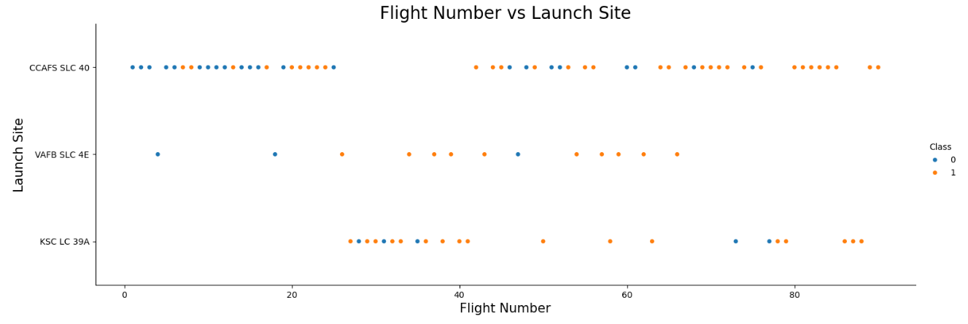
Flight Number vs. Launch Site
As the Flight Number increases, there is a general trend of more launches occurring over time. The distribution of launches varies across different launch sites, with some sites having a higher success rate than others. The patterns suggest that, over time, there has been an improvement in the success rate of launches at these sites.

Slide 19
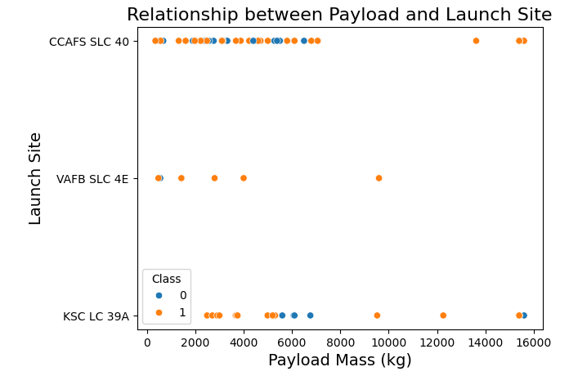
Payload vs. Launch Site
VAFB-SLC launch site there are no rockets launched for heavy payload mass(greater than 10000)

Slide 20
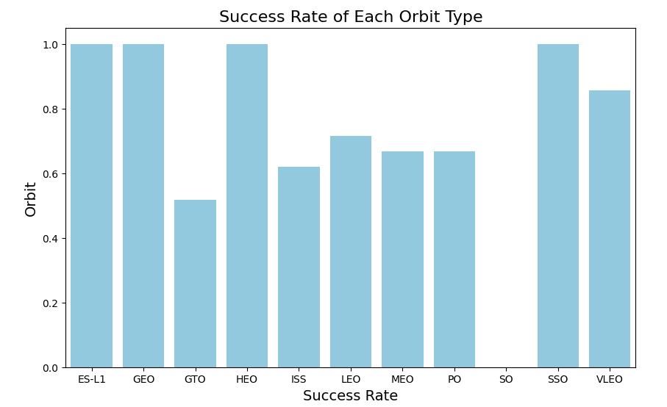
Success Rate vs. Orbit Type
Observations:
Orbits related to Earth observation, communication, and space station missions tend to have higher success rates.
Geostationary orbits (GEO) also show a high success rate.
Orbits associated with higher-energy trajectories, such as GTO (Geostationary Transfer Orbit), have a lower success rate compared to others.

Slide 21
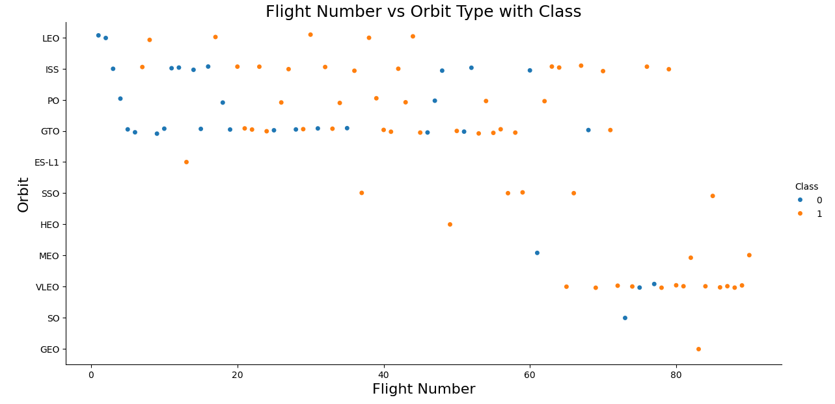
Flight Number vs. Orbit Type
In the LEO orbit the Success appears related to the number of flights; on the other hand, there seems to be no relationship between flight number when in GTO orbit.

Slide 22
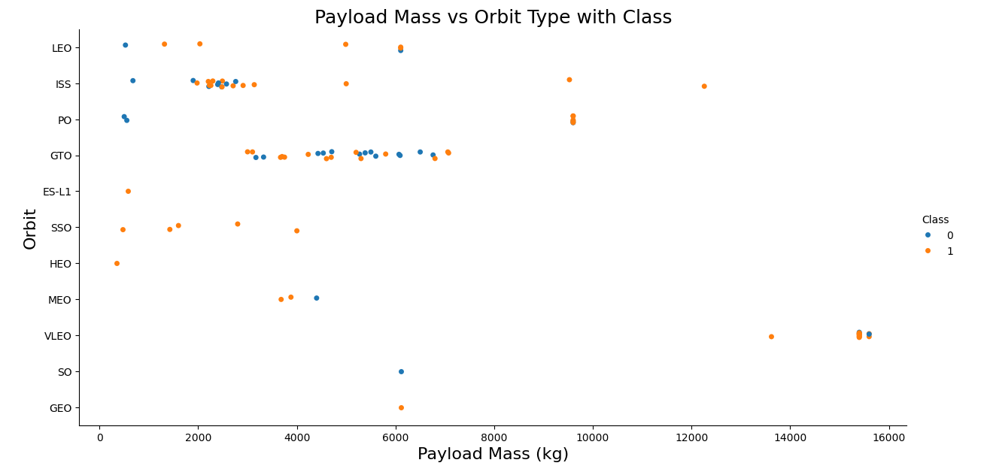
Payload vs. Orbit Type
With heavy payloads the successful landing or positive landing rate are more for Polar, LEO and ISS.
However, for GTO we cannot distinguish this well as both positive landing rate and negative landing(unsuccessful mission) are both there here.

Slide 23
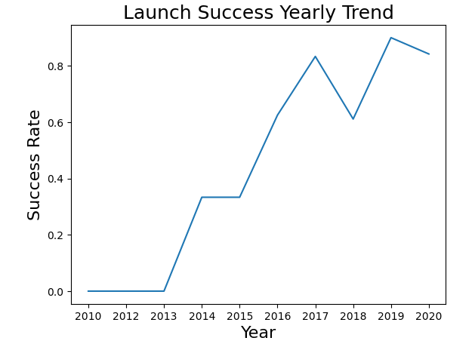
Launch Success Yearly Trend
The success rate since 2013 kept increasing till 2020

Slide 24
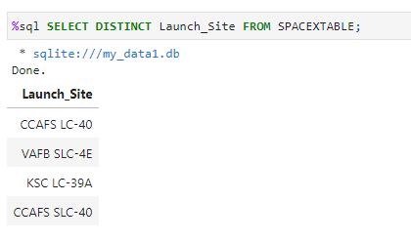
All Launch Site Names
We used this query to find the names of the unique launch sites
We can see the use of select Distinct to get this result

Slide 25
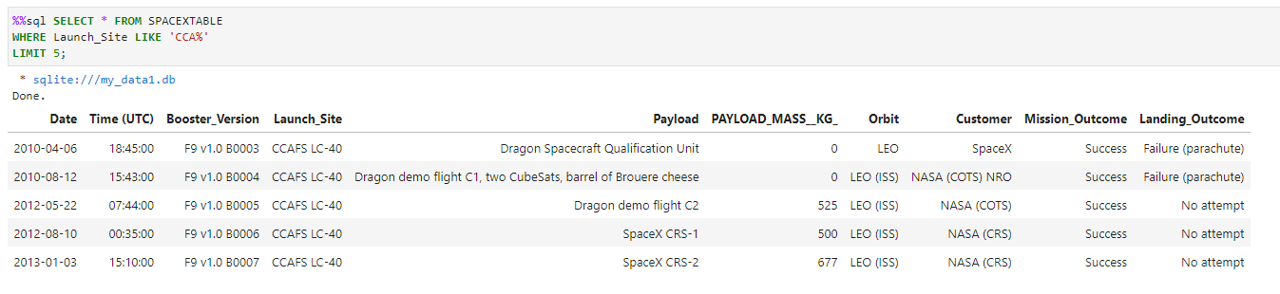
Launch Site Names Begin with 'CCA'
Using this query, we found 5 records where launch sites begin with `CCA`
We can see the use of “where … like …” and “limit 5” to get this result

Slide 26
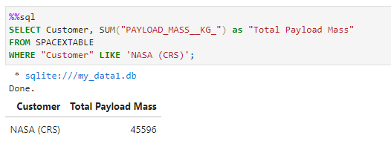
Total Payload Mass
We calculated the total payload carried by boosters from NASA
We can see the use of “where … like …” to get this result

Slide 27
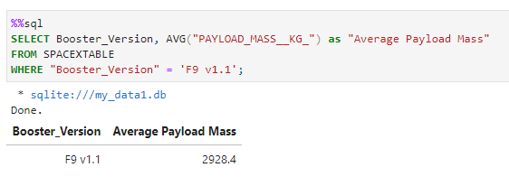
Average Payload Mass by F9 v1.1
We calculated the average payload mass carried by booster version F9 v1.1
We can see the use of AVG to get this result

Slide 28
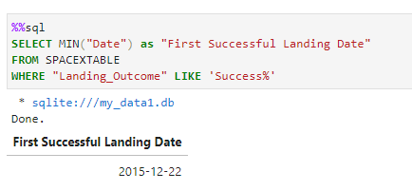
First Successful Ground Landing Date
We found the date of the first successful landing outcome on ground pad
We can see the use of min function to get this result

Slide 29
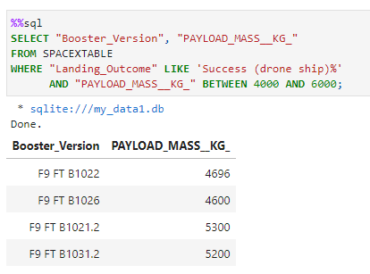
Successful Drone Ship Landing with Payload between 4000 and 6000
We listed the names of boosters which have successfully landed on drone ship and had payload mass greater than 4000 but less than 6000
We can see the use of Between to apply the condition

Slide 30
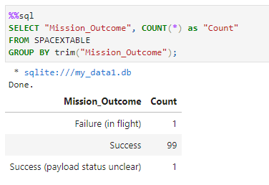
Total Number of Successful and Failure Mission Outcomes
We calculated the total number of successful and failure mission outcomes
To get this result, we used “Count” and “Group by”

Slide 31
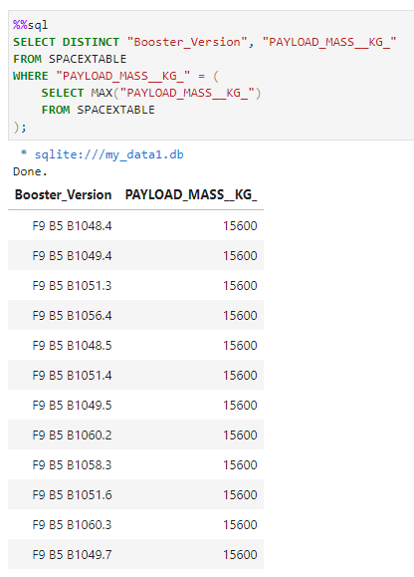
Boosters Carried Maximum Payload
We listed the names of the boosters which have carried the maximum payload mass
We use max function to get this result

Slide 32
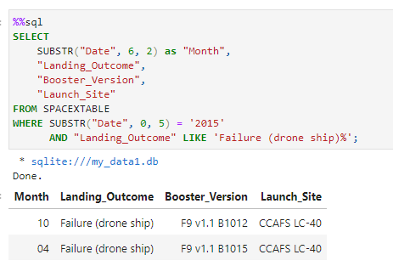
2015 Launch Records
We listed the failed landing_outcomes in drone ship, their booster versions, and launch site names for in year 2015
We used multiple conditions for this query

Slide 33
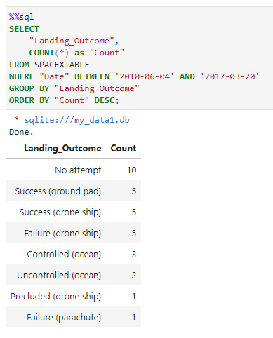
Rank Landing Outcomes Between 2010-06-04 and 2017-03-20
We ranked the count of landing outcomes (such as Failure (drone ship) or Success (ground pad)) between the date 2010-06-04 and 2017-03-20, in descending order
We used multiple conditions and “Group by” for this query

Slide 34

Section 3

Slide 35
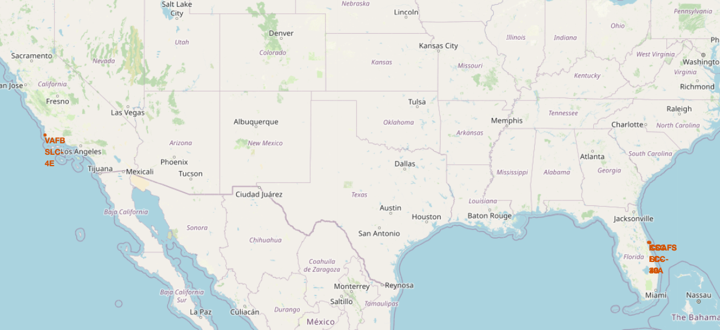
Launch sites’ locations on the map
We created a map with Folium and marked all launch sites’ locations on the map

Slide 36
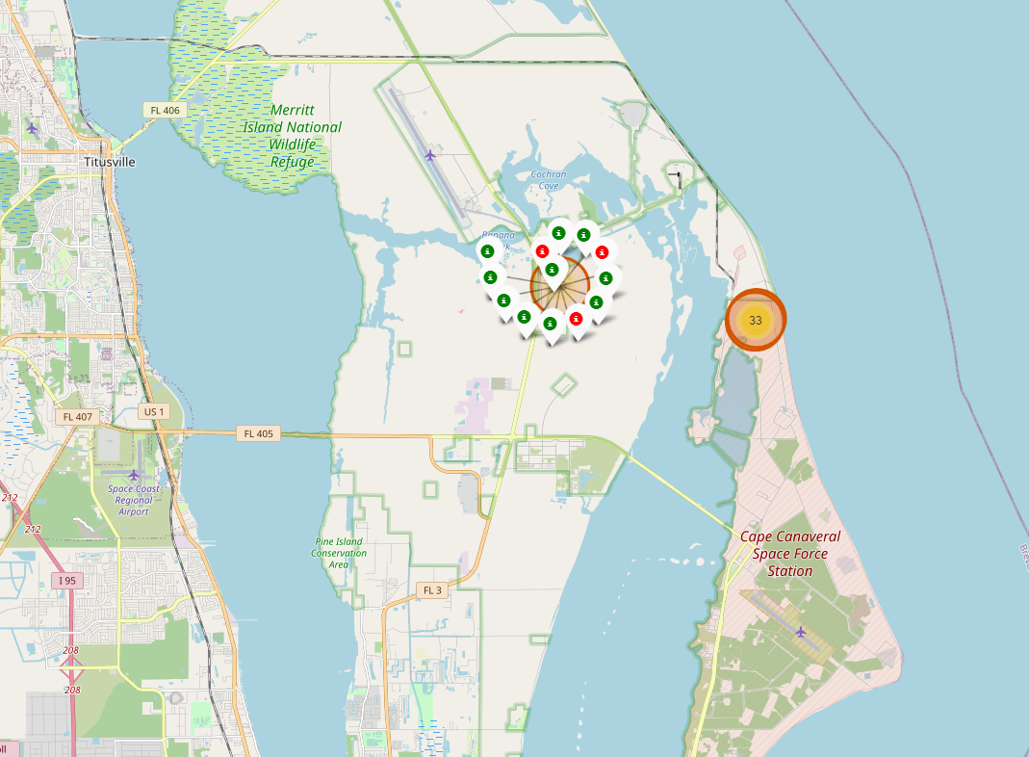
Color-Labeled Launch Outcomes
We updated our map to color-label launch outcomes on the map

Slide 37
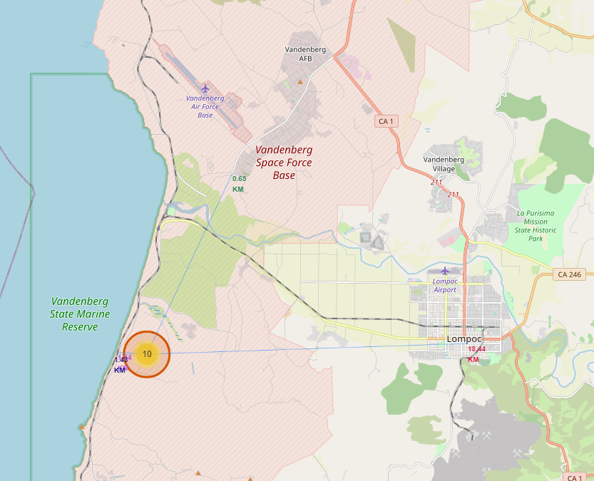
Site distance to its proximities
We updated the map to draw a PolyLine between a launch site to the selected coastline point

Slide 38

Section 4

Slide 39
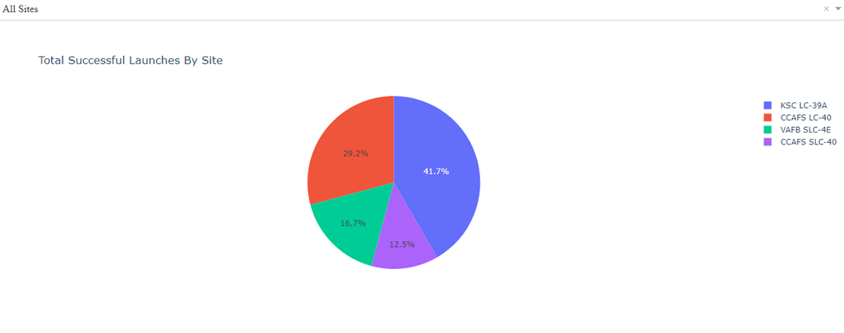
Successful Lunches by Site
As we see, KSC LC-39A has the most successful lunches

Slide 40
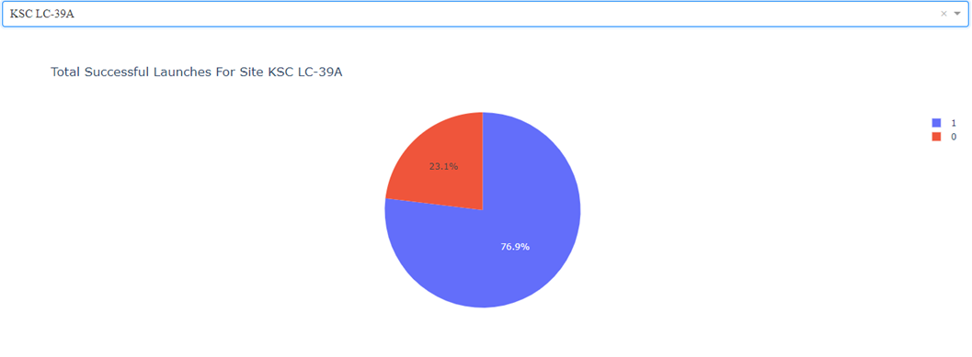
Success Ratio for the Site with the Highest Lunch
Success ratio for KSC LC-39A (The site with most successful )lunches

Slide 41
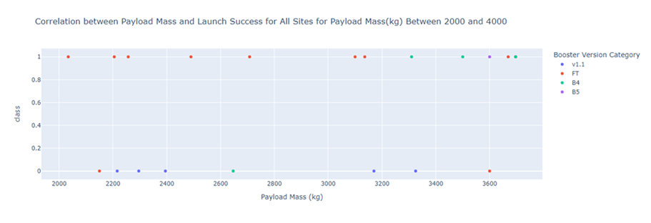
Payload vs. Launch Outcome
Correlation between payload Mass and Launch Success

Slide 42

Section 5

Slide 43
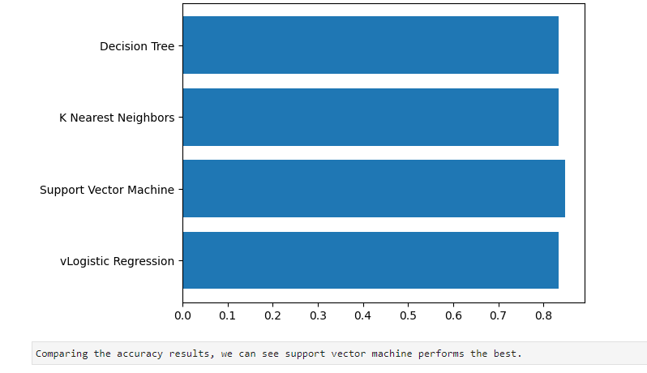
Classification Accuracy

Slide 44
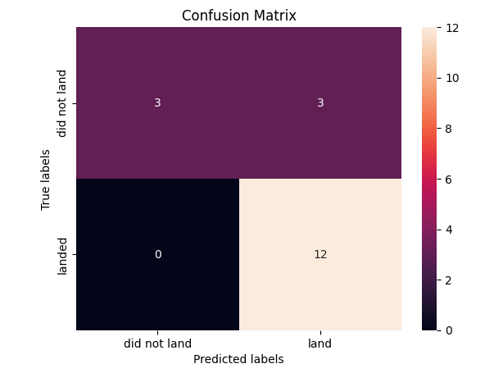
Confusion Matrix
The confusion matrix of the Support Vector Machine model.
As we see, there are three incorrect prediction.

Slide 45
Conclusions
Model Excellence: Logistic Regression excelled with an 82% accuracy, surpassing SVM, Decision Tree, and KNN. Its selection establishes a reliable basis for decision-making.
Financial Impact: Cost estimation models revealed substantial cost reduction with successful Falcon 9 landings, emphasizing the practical significance in aerospace decision-making.
Decision-Making Foundation: Logistic Regression's high accuracy positions it as an optimal predictor, providing a sturdy foundation for strategic planning.
Holistic Approach: Integrated methodologies offer a comprehensive solution to real-world challenges, with versatile applications in the aerospace industry.
Industry Relevance: Beyond Falcon 9, the project's methodologies hold broader applications, contributing to efficient resource allocation across the sector.
Continuous Enhancement: Logistic Regression's success lays the groundwork for ongoing improvements, exploring advanced features and techniques.
Educational Significance: Serving as an educational resource, the project exemplifies the application of data science in solving real-world challenges.
Scalability Potential: Developed methodologies offer scalability for similar aerospace challenges, serving as adaptable templates for decision support systems.

Slide 46
Appendix
Everything related to this project, including this presentation, the Python notebooks, and the data sets are available here:
https://github.com/msdoust/IBM-DataScience_SpaceX_Landing

Slide 47


